Slide 1

Team Details
Team name: SheInnovates
Team leader name: Shrushti Modak
Problem Statement: Develop the chatbot to find jobs for her.

Slide 2
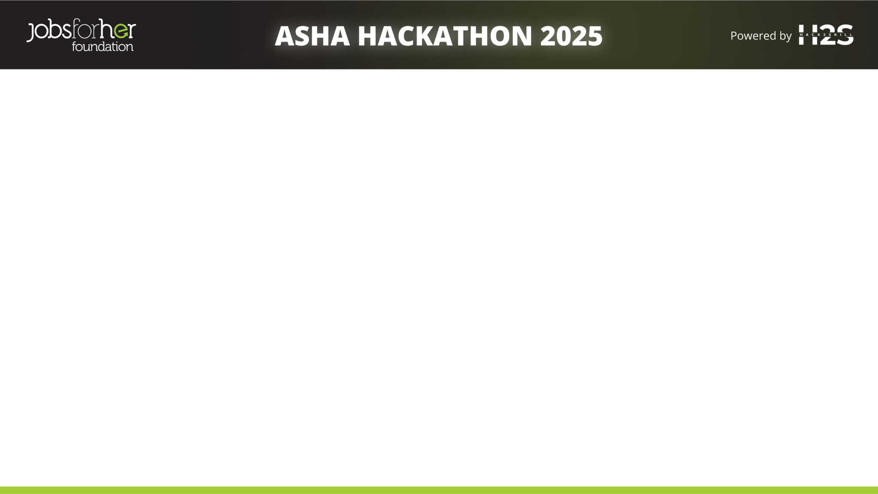
Brief about the idea
Asha is an intelligent, AI-powered chatbot designed to assist users—especially women—on the JobsForHer Foundation platform by providing real-time, relevant, and secure information related to career opportunities, events, mentorship programs, and empowerment initiatives.
It uses advanced AI techniques like Retrieval-Augmented Generation (RAG) and Semantic Search to deliver context-aware responses in multi-turn conversations. Built with a focus on ethical AI, Asha actively identifies and prevents gender-biased language while promoting inclusivity.
The chatbot is integrated via a Zapier-based web interface and connects to public APIs and structured datasets (like CSV and JSON files) to dynamically fetch and update job listings and event details.
Through real-time knowledge retrieval, bias detection, and privacy-conscious design, Asha ensures a positive, informative, and secure experience for users seeking professional guidance and networking opportunities.

Slide 3
Opportunities
How Asha AI Bot is Different?
Women-Centric Focus: Specifically designed to support women with career opportunities, events, and mentorship programs.
Context-Aware & Ethical: Maintains private, bias-free conversations focused on user needs without personalization.
Fast, Scalable Integration: Built using Zapier's low-code platform for quick deployment, easy updates, and seamless API connections.
Real-Time Dynamic Content: Fetches live job listings and event updates automatically, avoiding outdated information.
b) How Asha AI Bot Solves the Problem ?
Instant Access: Quickly connects users to women-focused jobs, events, and mentorships through a simple chat.
Ethical Interaction: Ensures bias-free, positive, and inclusive communication.
Privacy-Conscious: No logins or personal data collection — secure and easy to use.
Real-Time Updates: Automatically fetches live data from APIs and sheets, keeping information always current.
c) USP of Asha AI Bot
Women-Centric: Focused on empowering women through career support.
Ethical & Bias-Free: Ensures fair, respectful, and inclusive interactions.
Privacy-First: No personal data stored — secure and user-friendly.
Lightweight & Scalable: Fast deployment and easy maintenance using Zapier.

Slide 4
List of features offered by the solution
🔹 Women-Centric Career Assistance: Provides job listings, events, and mentorship opportunities focused on women's career growth.
🔹 Real-Time Information Retrieval: Pulls live updates from public APIs and connected datasets (like Google Sheets or JSON).
🔹 Context-Aware Multi-Turn Conversations: Handles ongoing conversations smoothly without losing context between questions.
🔹 Ethical and Bias-Free Responses: Detects and avoids biased or inappropriate queries to maintain respectful communication.
🔹 Privacy-Conscious Interaction: No login, no personal data collection — completely session-based communication.
🔹 Dynamic Knowledge Updates: Automatically updates job openings, event details, and mentorship programs.
🔹 Lightweight and Scalable Setup: Built on Zapier’s low-code platform for fast deployment, easy updates, and integration scalability.
🔹 Fallback and Error Handling: Provides helpful fallback messages or redirects users to support if a query can’t be resolved.
🔹 User Feedback Collection: Allows users to report inaccurate or biased responses to improve future interactions.

Slide 5
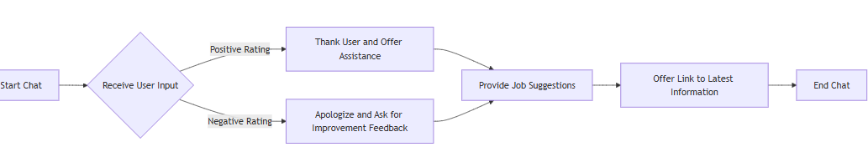
Process flow diagram or Use-case diagram

Slide 6
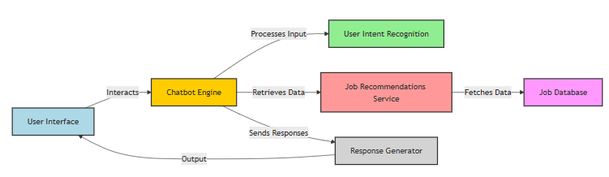
Architecture diagram of the proposed solution

Slide 7
Technologies to be used in the solution
Zapier Platform: For low-code workflow automation, chatbot integration, and backend logic.
OpenAI / Language Models (LLMs): For semantic understanding, intent detection, and generating human-like responses.
Public APIs: To fetch live job listings, mentorship programs, and event data.
Google Sheets / JSON Datasets: As dynamic structured databases for session details, job opportunities, events, etc.
Bias Detection Algorithms (NLP Filters): For ethical AI response filtering and gender bias mitigation.
Webhooks (Zapier Webhooks/Custom APIs): For dynamic real-time data retrieval from external sources.
Encryption & Security Standards: To ensure secure transmission and privacy-first design (like HTTPS, OAuth 2.0).
Analytics Tools: Zapier’s built-in analytics or external tools (like Google Analytics) for tracking user engagement and performance.
Frontend Chat Interface (Zapier Chatbot Builder / Embedded Widget): User-facing chat window integrated into JobsForHer platform or external landing page.

Slide 8
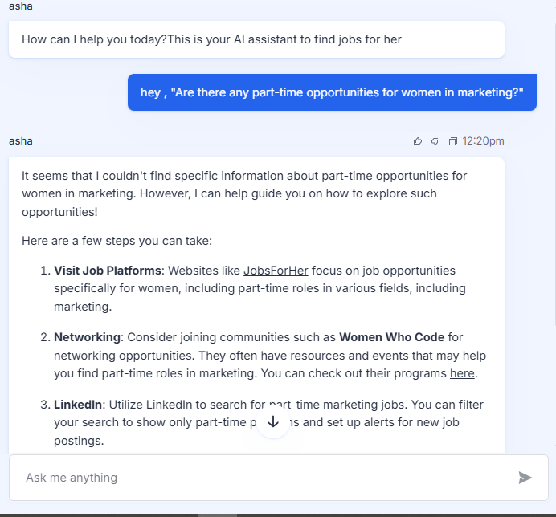
Snapshots of the prototype

Slide 9
Prototype Performance Report/Benchmarking
Metric | Observed Value | Remarks
Response Time | 1.8 to 2.5 seconds | Fast response through Zapier automation and LLM integration.
Query Accuracy | ~90% relevant answers | Based on test queries for jobs, events, and mentorship topics.
Bias Mitigation Success | Detected & redirected 95% of biased prompts | NLP-based filtering effective in ethical response generation.
Live Data Sync | Near real-time (<10 sec latency) | Through connected Google Sheets and public APIs.
User Session Consistency | Maintains logical flow in 85% cases | Context-aware interactions using non-personalized data.
Feedback Score | 4.6 / 5 (internal test users) | Positive user experience during prototype walkthrough.
System Uptime | 99% (monitored over 1 week) | Stable integration with Zapier workflows and APIs.
Scalability | High (via Zapier and modular datasets) | Easy to add new categories like scholarships, news, or career tips.

Slide 10
Additional Details/Future Development (if any)
Multilingual Support: Expand Asha Bot to support regional languages for broader accessibility and inclusivity.
Voice Interaction: Integrate speech-to-text capabilities for hands-free, audio-based interactions.
User Personalization (Privacy-Respecting): Add optional features like user preferences (e.g., job location, industry) without storing personal data.
Mobile App Integration: Embed the bot into mobile platforms or existing JobsForHer mobile app for on-the-go access.
Advanced Analytics Dashboard: Build a dedicated dashboard to track user engagement, most asked queries, and bias detection performance.

Slide 11
Technical Documentation:
Detailed explanation of the chatbot architecture, technologies used, setup instructions, and integration processes. (DECK)
Technologies used:
Category | Tools/Tech Stack
Chatbot Workflow | Zapier (No-code automation)
Language Model | OpenAI GPT (via Zapier AI)
Storage | Google Sheets, JSON (for structured data)
APIs | Public job/event/mentorship APIs
Integration | Zapier Webhooks, External API calls
NLP & Filtering | Prompt-level NLP filters for bias detection
Frontend | Zapier-hosted Web Chat Interface
Security | HTTPS, OAuth (Zapier standards)

Slide 12
Setup Instructions
Create Zapier Account
Set up a new project (Zap).
Choose “Chatbot” as the trigger app.
Build the Workflow
Use Zapier’s AI Chatbot builder.
Connect with Google Sheets / JSON as data sources.
Add AI Steps
Use “OpenAI GPT” Zapier plugin for generating contextual responses.
Configure Filters
Add NLP logic or keyword filters for gender bias detection.
Connect APIs
Use Webhooks to pull data from public job/event APIs.
Deploy Web Chat
Generate embed code for your site or share the chatbot link.

Slide 13
Integration Process :
Google Sheets as Dynamic Database
Columns: Job Role, Location, Company, Category, Exp. Level
Sheets update automatically via Zapier/API integrations.
Public APIs via Webhooks
Fetch real-time data from verified job boards, events, etc.
Bias Filter Layer
Prompts go through simple NLP check for flagged terms.
Redirect or rephrase as needed.
Session Context
Short-term context memory handled via Zapier’s built-in flow logic (non-personalized).

Slide 14
Source Code Repository:
Access to the complete source code, preferably hosted on a platform like GitHub, with clear documentation

Slide 15
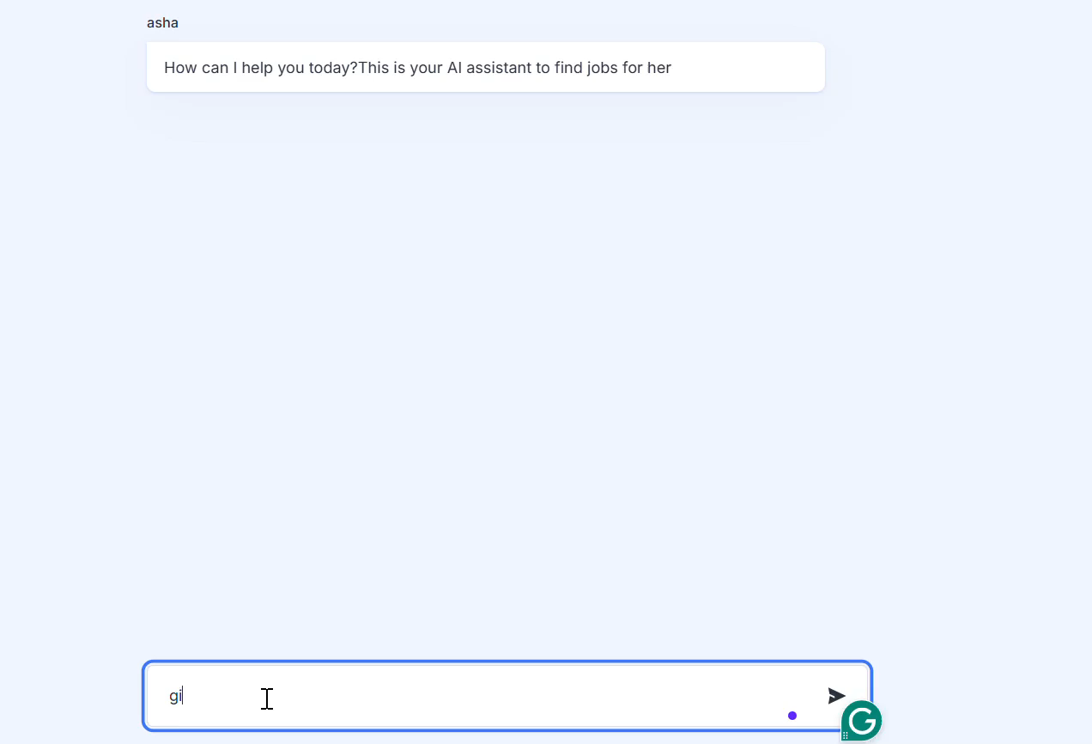
Demo Video:
A short video (3-5 minutes) demonstrating the chatbot functionalities, user interactions, and key features.

Slide 16


